Slide 1
Bengali to English Translation Using Pre-trained Models
PRESENTED BY
GROUP-4:
1) SHUBHAM SARKAR
2) SREYAN DEY
3) SOUMIK MUKHERJEE
4) SAIKAT MAITY

Slide 2

OBJECTIVE AND MOTIVATION
Objective: To develop a Bengali to English translation system using existing pre-trained large language models (LLMs).
Motivation: Accurate translation is crucial for communication in a multilingual world. Bengali, being the 7th most spoken language, requires robust translation solutions for wider accessibility.

Slide 3
Problem Statement
Challenge: Translating Bengali to English accurately using pre-trained models, ensuring minimal loss in context and meaning.
Issues with Current Systems:
Lack of high-quality datasets specifically for Bengali.
Existing models often trained primarily on more common languages like English, Spanish, French, etc.
Variability in translation quality between different models.

Slide 4
Proposed Solution
Dataset Preparation: Manually curate a dataset of Bengali to English translations, ensuring a diverse representation of sentence structures and contexts.(Surveying)
Use Pre-trained LLMs: Employ various pre-trained LLMs to translate English sentences back to Bengali.
Evaluation Metrics: Use metrics like BLEU, ROUGE, and METEOR to compare the quality of translations against the original dataset.
Model Comparison: Evaluate the performance of at least 5 foundational models on the task

Slide 5
Workflow Overview
Step 1
Step 3
Step 2
Step 4
Step 6
Step 5
Load Dataset Load the dataset containing Bengali sentences (and possibly their English translations) from a CSV file.
Preprocess Data
Tokenize, clean, and prepare the text data for input into the translation models
.
Initialize Metrics Set up evaluation metrics that will be used to assess the quality of the translations. Common metrics include BLEU, ROUGE-L, METEOR, and BERTScore.
Load Translation Models Load multiple pre-trained translation models, each capable of translating Bengali to English. (mBART-large, OPUS-MT, NLLB-200, mT5-small, and IndicTrans-v2)
Iterate Through Models Loop through each translation model to evaluate its performance on the dataset.
Batch Processing Process the dataset in batches to efficiently manage computational resources and ensure that translations are generated quickly.

Slide 6
Workflow Overview
Step 7
Step 9
Step 8
Step 10
Step 12
Step 11
Translate Texts Use each model to translate the Bengali sentences to English.
Calculate Scores Compare the translated sentences to the reference translations using the initialized metrics.
Store Results Store the results of each model's translations and their respective scores.
Aggregate Results If multiple models are used, aggregate their results to provide a comprehensive evaluation.
Save Detailed CSV Save the detailed results, including translations and metric scores, in a CSV file for further analysis.
Generate Report Compile the results into a final report that summarizes the performance of each model.

Slide 7
Dataset
Source: Surveying.
Size: Approximately 300 sentences.
Quality Control: Reviewed by native speakers for accuracy and context appropriateness.
Challenges: Ensuring a balanced dataset with complex and simple sentences.

Slide 8
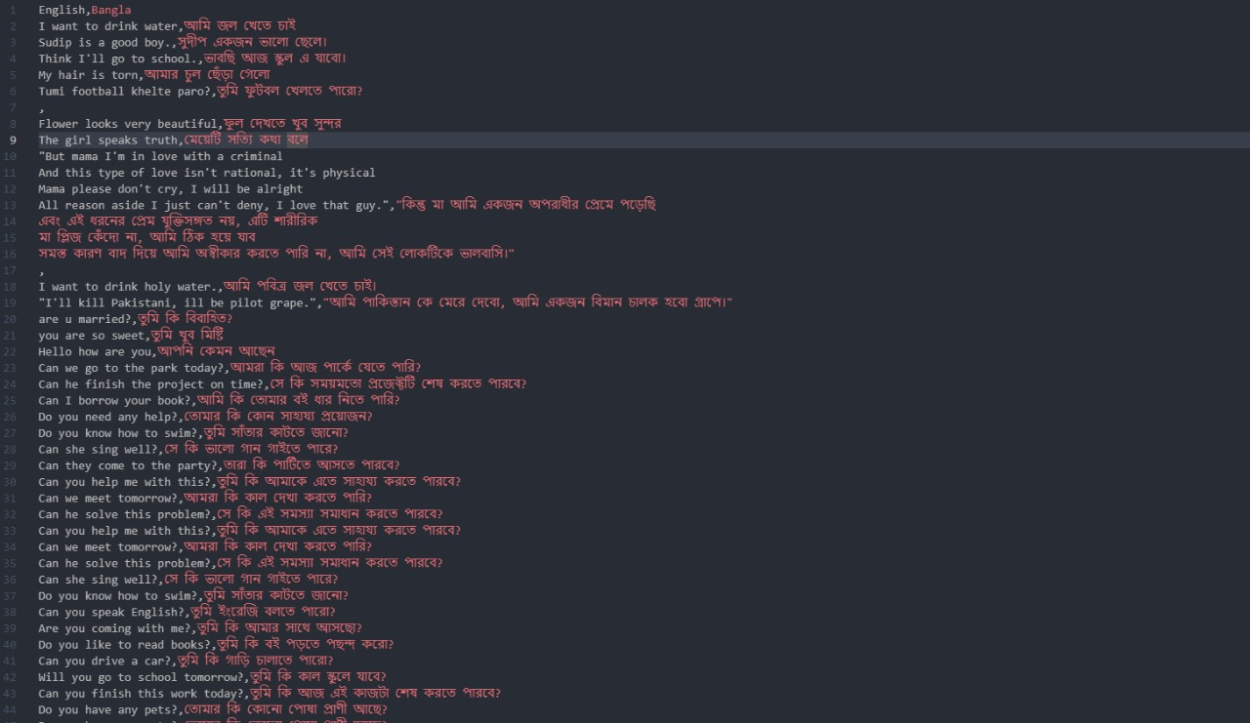

Slide 9
Explanation of Key Components
Preprocessing :
Tokenization, Normalization: Prepare the text data by breaking it down into tokens and ensuring consistency in text formats.
Positional Encoding: Ensure that the order of words is preserved and understood by the model.
Pre-trained Models Used:
facebook/mbart-large-50-many-to-many-mmt
Helsinki-NLP/opus-mt-en-bn
facebook/nllb-200-distilled-600M
google/mt5-small
ai4bharat/indictrans-v2-en-bn
ai4bharat/indic-bert

Slide 10
Evaluation Metrics:
BLEU (Bilingual Evaluation Understudy): Measures the similarity between the model's translation and reference translations.
ROUGE-L: Focuses on the longest common subsequence between the generated and reference texts.
METEOR: Considers synonyms and stemming, providing a more linguistically informed evaluation.
BERTScore: Uses BERT embeddings to measure the semantic similarity between sentences.

Slide 11
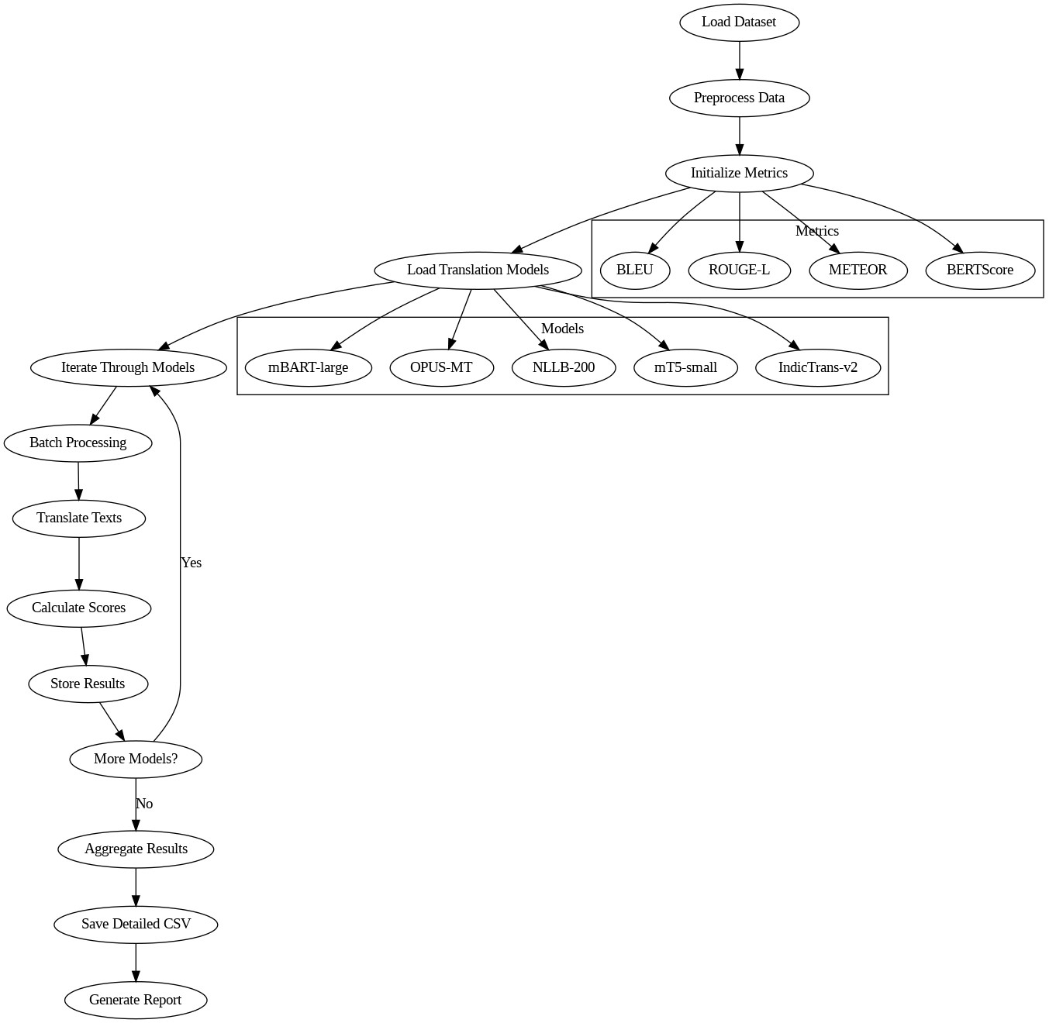
WORKFLOW DIAGRAM:

Slide 12
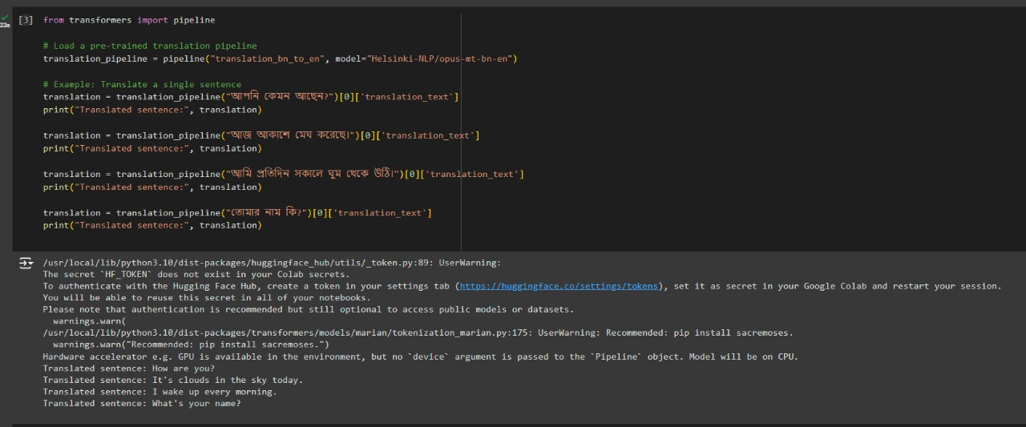
OUTPUT:

Slide 13
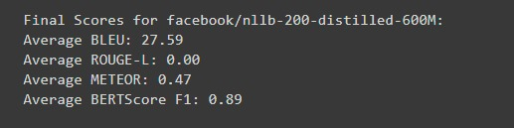
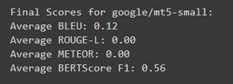
RESULT ANALYSIS:
Performance Comparison:
NLLB
MT5
Diversity : Each model has unique strengths, covering a range of capabilities from general multilingual translation to specialized low-resource translation.
Complementarity : By using multiple models, you can cross-validate results, ensuring robustness and accuracy in the translation outputs.

Slide 14
CONCLUSION:
Key Findings:
LLMs show promising results in Bengali to English translation but vary significantly in quality.
Foundation models trained on multilingual datasets perform better on low-resource languages.
Recommendations:
Incorporate more domain-specific training data.
Explore model fine-tuning specifically for Bengali-English translation.
Future Work:
Extend evaluation to include human assessments.
Explore neural machine translation (NMT) systems dedicated to Bengali.

Slide 15
MAIN CODE
DATA PREPROCESSING CODE

Slide 16


